Slide 1


Exercise Sets, Faculty Commons, and Resources of the PICUP Website
Todd Zimmerman
University of Wisconsin – Stout
Summer AAPT Meeting
July 12, 2022
Link to slides
Notes:
Abstract: “Over the past several years, the Partnership for Integrating Computation into Undergraduate Physics (PICUP) has curated a collection of materials to help instructors add in computational modeling to their courses. I’ll discuss the various resources and how you can contribute to the community.”
Todd Zimmerman
Editor-in-Chief of the PICUP Collection
My goal in this talk is to give some perspective of how far PICUP has come in integration computational modeling into the physics curriculum and to point out directions we might go.

Slide 2

Mission of PICUP
Lower the barriers to integrating computation into classes
Community
Training
Resources
Notes:
A little about me
Undergrad at Lawrence
2nd class to benefit from computational physics suite create by David Cook
Grew up thinking computation was normal part of curriculum
Started teaching and realized not everyone did it that way
Instructors thought I was crazy for teaching CS in physics
First heard about PICUP at 2016 Global Physics Department
Applied for FDW before finished video
At FDW realized I had found a place I belonged
People there saw not just potential of computation but the fundamental need to include computation in undergrad curriculum
Ring-side seat over past several years watching community grow
Watching resources to lower barrier grow
Mission
Focus on resources

Slide 3
Computation in Physics - Definition
Having students work with simulations and/or algorithms, giving students pieces of code to complete on their own, and/or advising students on undergraduate research projects where they write code from scratch¹
1. Caballero, Marcos D., and Laura Merner. "Prevalence and nature of computational instruction in undergraduate physics programs across the United States." Physical Review Physics Education Research 14.2 (2018): 020129.
Notes:
My thought is if your hands are on the keyboard, mouse, or touch screen and you are trying to understand physics at that time, it’s computation.

Slide 4
A Brief History
2006 – Shodor Visioning Workshop – PICUP is born
2006 - Special issue on computation in physics in Computing in Science and Engineering
Fuller – “Numerical Computations in US Undergraduate Physics Courses”¹
2008 – “Integrating computation into the undergraduate curriculum: A vision and guidelines for future developments”²
AJP article by Chonacky and Winch
2011-2013 – Development workshops
2013 – Present Workshops at various conferences
2015 – Two NSF proposals for PICUP funded
M.D. Caballero, K. Roos, L. Engelhardt, M. Lopez, R. Hilborn, N. Chonacky
2016 - First Faculty Development Workshop
gopicup.org
2018 – “On the Prevalence and Nature of Computational Instruction in Undergraduate Physics Programs across the United States”³
2020 First virtual workshop
Notes:
EDIT TO OUTLINE
As a result of an AAPT cracker-barrel, David Winch and Norman Chonacky (along with many others) started to plot a campaign to infuse computation into undergraduate physics.
During a 2006 workshop funding by the Shodor Education Foundation, PICUP was born
Norman Chonacky and David Winch put together a special issue of Computing in Science and Engineering on the use of computation in physics
They worked with Robert Fuller to survey faculty on their beliefs and useage of computation
In an article by Winch and Chonacky in AJP they put forth recommendations for the physics community
Two development workshops and a FDW pilot workshop held between 2011 and 2013
Several workshops at conference
Two NSF grants funded in 2015, which led to first FDW
A 2018 paper by Danny Caballero and Laura Merner provides a more current view on the state of things so far.
With ending of NSF grant and pandemic

Slide 5
Numerical Computations in US Undergraduate Physics Courses¹
Survey for faculty on importance and use of computation (N=187)
Large fraction thought computation important
<20% included computation in grades
1) Fuller, Robert G. "Numerical computations in US undergraduate physics courses." Computing in science & engineering 8.5 (2006): 16-21.
Notes:
Norman Chonacky, David Winch, and Robert Fuller sent out a survey exploring how important faculty thought computation was in the physics curriculum and how it was used
135 out of roughly 900 faculty responded to the survey.
This paper (and the issue) helped continue a conversation that had started as a ”heated discussion” at the previous Salt Lake City AAPT meeting.

Slide 6
On the Prevalence and Nature of Computational Instruction in Undergraduate Physics Programs across the United States¹
Response: 357 departments and 1246 faculty
>50% of departments have 1 faculty teaching computation in intro and upper level courses
>25% of departments have ½ of faculty teaching computation in intro and upper level courses
Related paper on barriers²
Caballero, Marcos D., and Laura Merner. "Prevalence and nature of computational instruction in undergraduate physics programs across the United States." Physical Review Physics Education Research 14.2 (2018): 020129.
Leary, Ashleigh, Irving, Paul W., and Caballero, Marcos D. The difficulties associated with integrating computation into undergraduate physics. Proceedings of the Physics Education Research Conference (2018).
Notes:
Did find a growth in expertise from Chonacky and Winch but didn’t translate to as large a growth in the classroom.
There is follow-up research on the barriers by Leary, Irving and Caballero in the 2018 PERC proceedings

Slide 7
PICUP
Website:
Exercise Sets
Faculty Commons
Resources Tab
Community and Events
Training:
FDW
Regional Workshops
Virtual Workshops
Site Visits
Webinars
Community
Webinars and Workshops
Slack Channel

Slide 8
PICUP
Website:
Exercise Sets
Peer-reviewed activities
Faculty Commons
All other curricular material
Resources Tab
Tips and best practices
Community and Events
Stay connected, get help

Slide 9
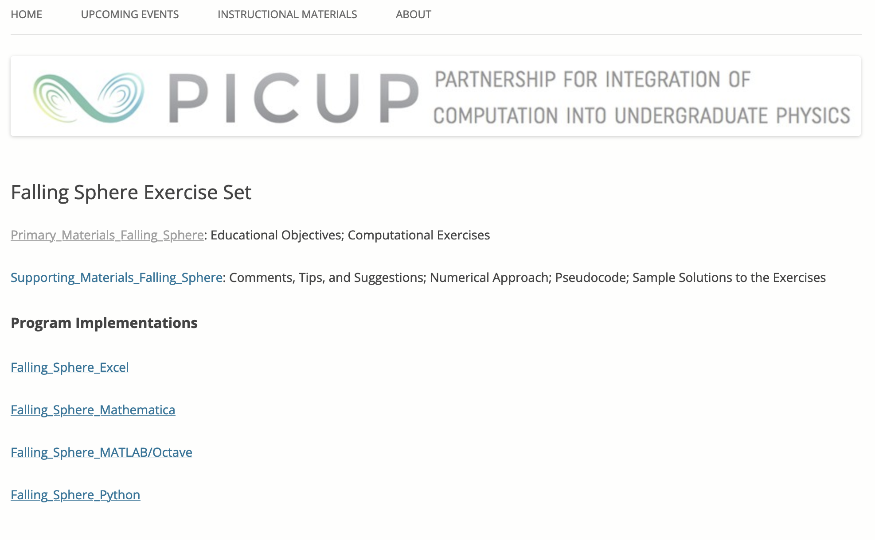
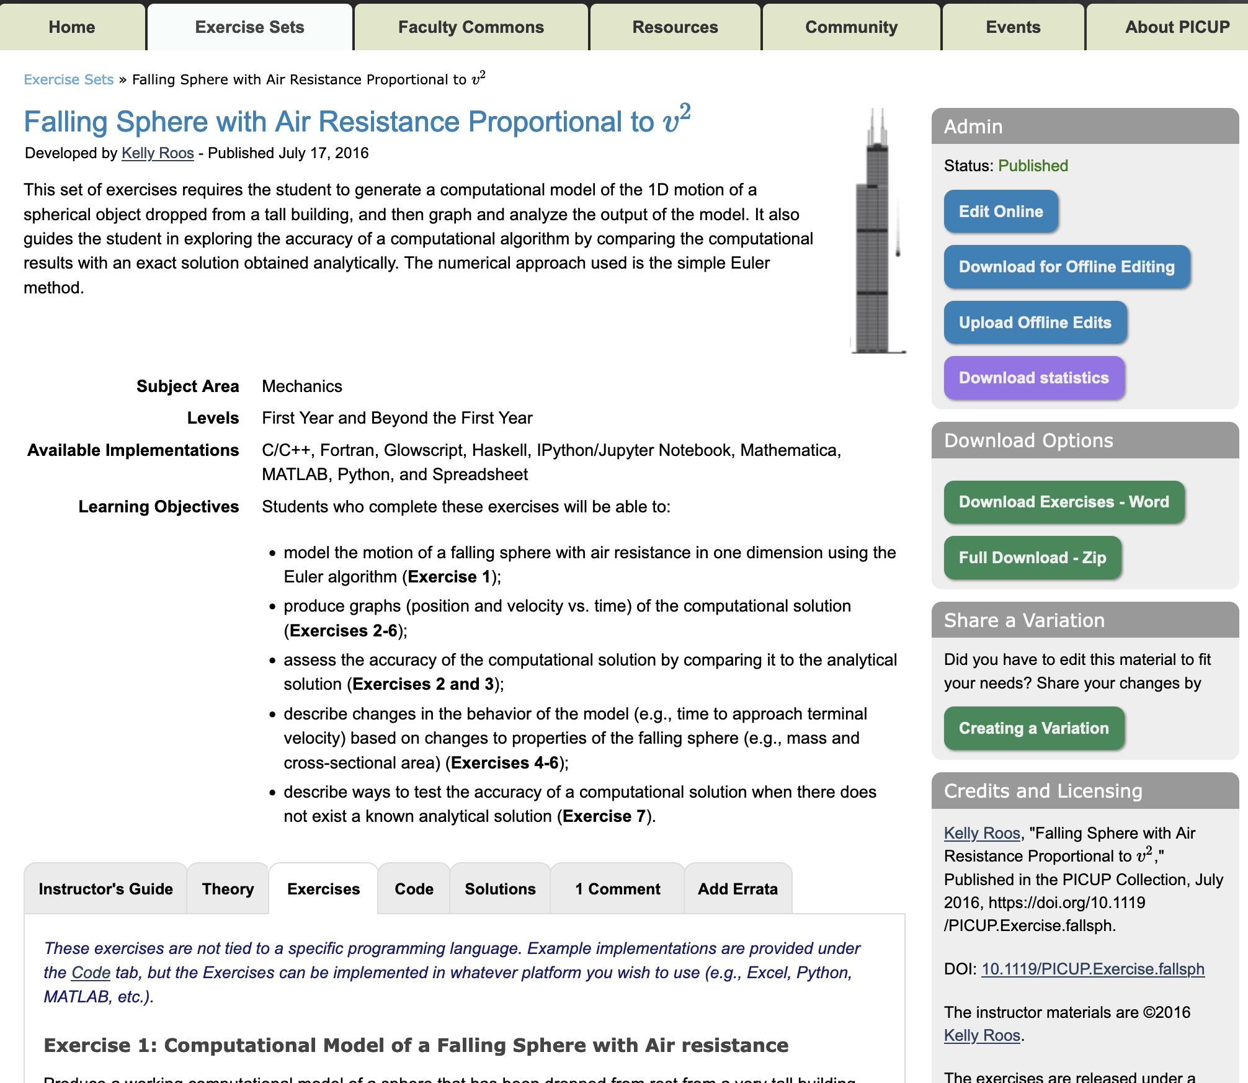
Then and Now
Old site: https://picupsite.wordpress.com/
Notes:
May be familiar with website
Always adding new features
Want to highlight the hard work that Lyle Barbato, Kelly Roos, Larry Engelhardt put in making invaluable resource

Slide 10
Exercise Sets (ES)
An Exercise Set is a set of peer-reviewed material that contains the following:
A brief description of the physics and computation
A list of learning objectives for the set
An instructor’s guide and theory section for background
A series of activities and questions (the exercises)
Code template and solutions in at least one programming language
Solutions
All Exercise Sets are peer-reviewed through semi-automated process
Collaborative peer-review
Notes:
Description, a few sentences discussing physics concepts and computational approach
Learning objectives, tied to specific exercise
Guide providing tips to instructor
Theory giving required background knowledge
Exercises themselves
Solutions
Most importantly, code templates for students and completed code for instructors in at least one programming language
Stress our peer-review goal is to help authors get ES to the point of publication, not accept/reject

Slide 11
Peer Review
Emails auto-generated
Due dates/reminder emails handled by server
Author submits Exercise Set (ES) material
Editor take responsibility for ES
Editor emails potential reviewers
Reviewers submit reviews
Editor contacts author for possible changes
Author submits changes
Published!
Notes:
Proud of peer review system we’ve compiled
Don’t know if this is useful to you but a lot of effort and continual improvements to process occurs out of sight.

Slide 12
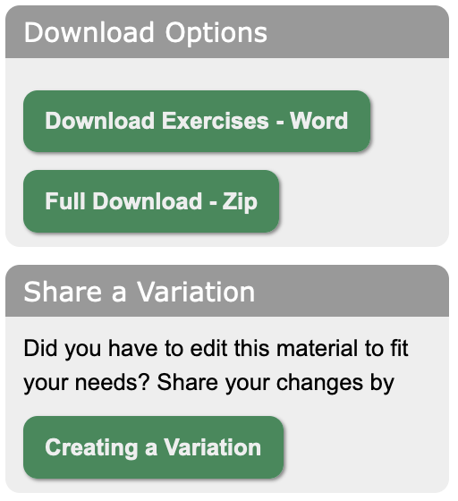
Why are ES special?
Complete package
Easy to download and modify
Can upload variants
Language agnostic
Templates and solutions available in one or more platforms
Peer-reviewed
Notes:
ES is complete set of curricular material
Could be run in class “as is”
Knowing physicists, they won’t so make it easy to modify
Download text files to make changes
Share variants
Strive for ES to not depend on specific language or platform – only templates and solution code language specific
As mentioned everything is peer reviewed.
This sets us apart from other repositories

Slide 13
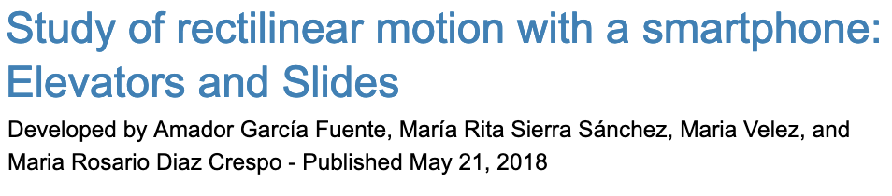

Multiple authors, non-faculty authors
Exercise sets can now have multiple authors
Students can be included as authors
Select “Non-Faculty Verification” on Registration page
Notes:
New feature is multiple authors for ES
Including students
Students register using non-faculty verification tab on registration page

Slide 14
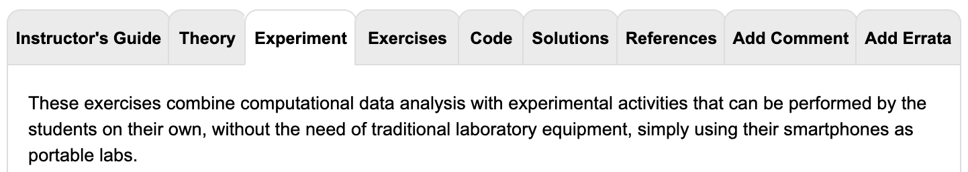
Experiments
Exercise sets can combine experiments with computation
Notes:
ES can have experimental components.
Experiment tab only shows up for those activities so not well known
Don’t have a lot of these yet but hope to get more

Slide 15
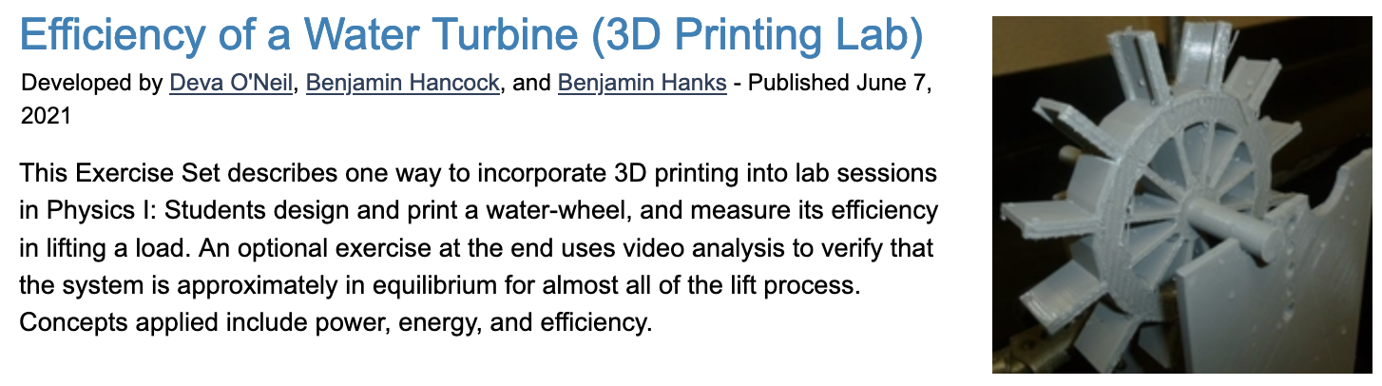
3D Printing
Can find 3D files under Additional Resources on the Code tab
Notes:
Authors can include 3d printer files like STL files
The 3D printed labs include experiments

Slide 16
Errata Tab
You can point out errors in ES
Notes:
Errata tab so anyone who finds typos or issues can alert us

Slide 17

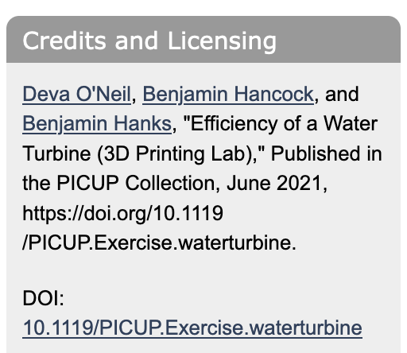
Digital Object Identifier (DOI)
All ES now have DOI’s
Notes:
DOI provide a fixed pointer to a set of digital information
Commonly used with digital journals
Hope this will provide a little more legitimacy for authors who want to include ES in hiring, retention, tenure or promotion documents
All ES now have DOIs

Slide 18
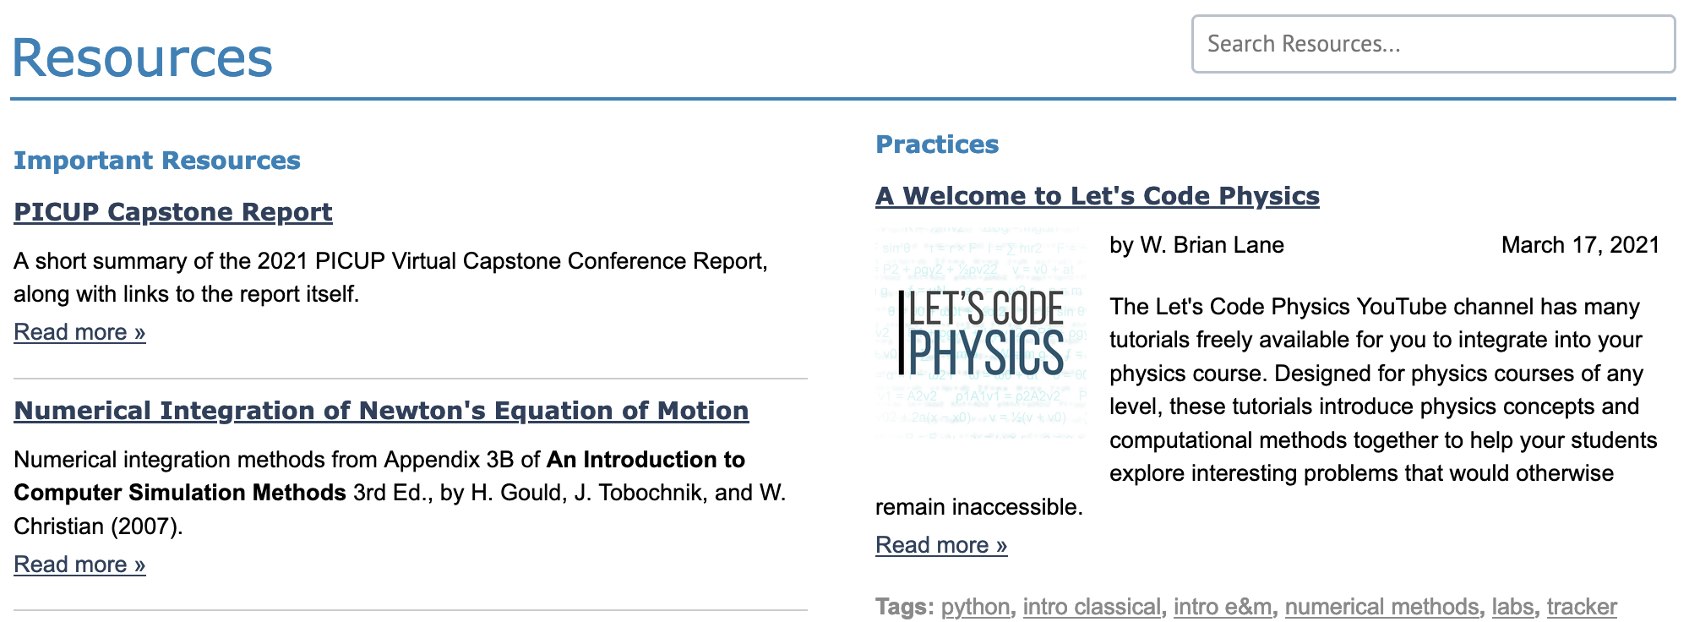
Resources Tab
Important Resources
Practices
Notes:
Important Resources like a textbook chapter on numerical integration methods
Now includes the capstone report
Practices are posts about things people have tried in their classes
Things that worked or didn’t work
Other resources people might find useful
BTW We are always looking for more posts. If you have something interesting you might like to share email me

Slide 19
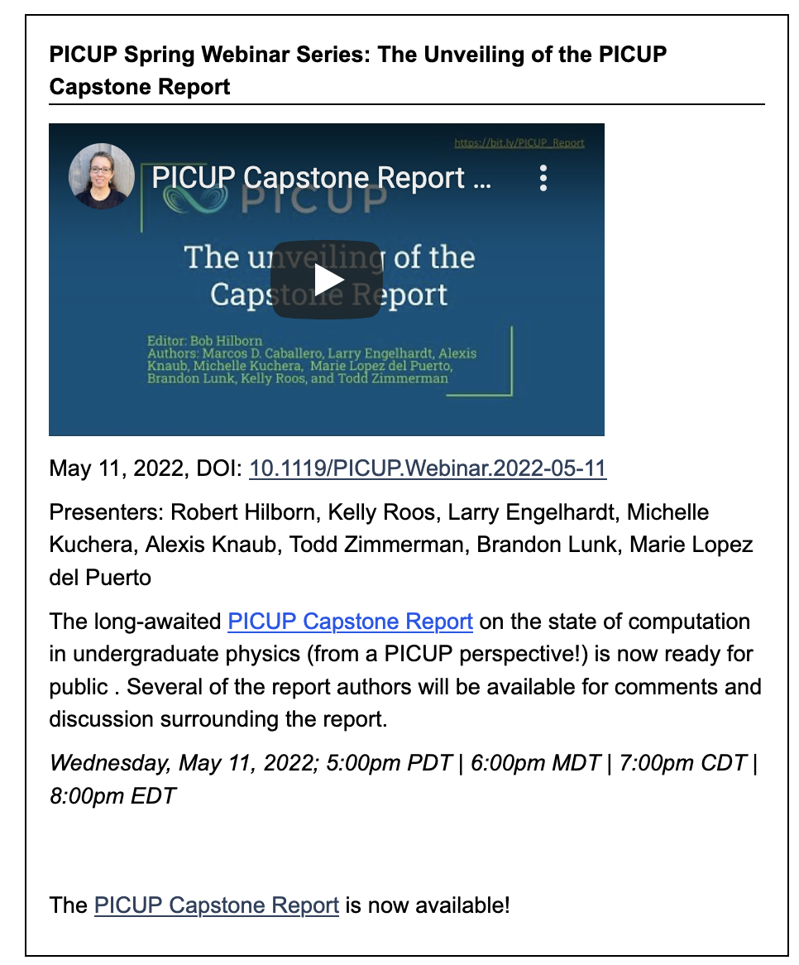
Community Tab
Collection of previous PICUP Webinar Series
Now include DOIs
Notes:
Community tab has link to sign up for Slack as well as previous synchronous webinars
Webinars are held montlyish during school year and provide a showcase of things people have tried in classes and also chance to connect with picupers
Now have DOIs

Slide 20

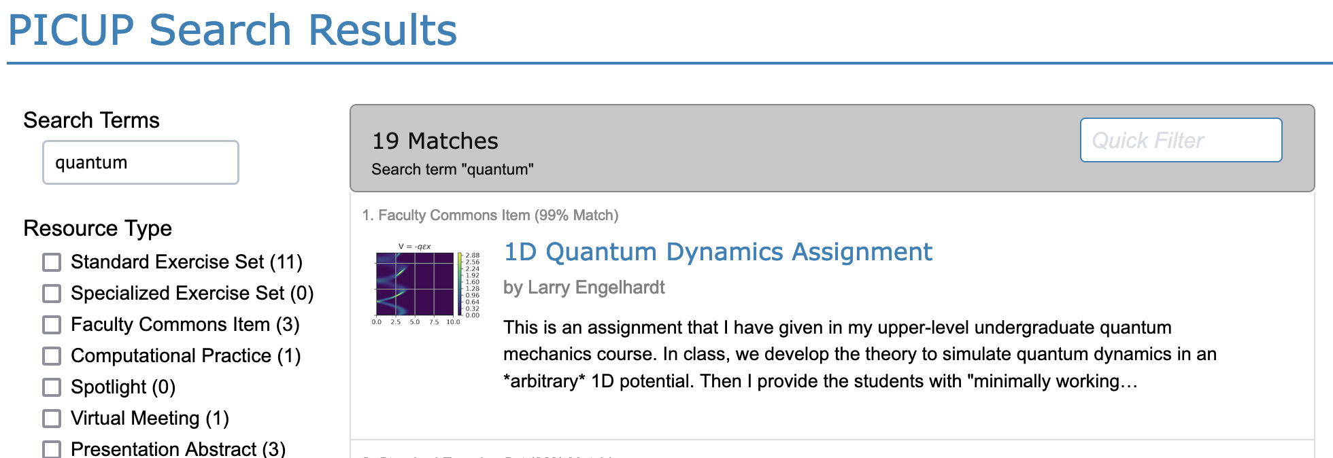
Site-Wide Searching
You can search:
Exercise Sets
Faculty Commons
Resources
Webinar abstracts
Conference abstracts
Notes:
Search entire site
I used to use Google to find things on site but now can search through…

Slide 21
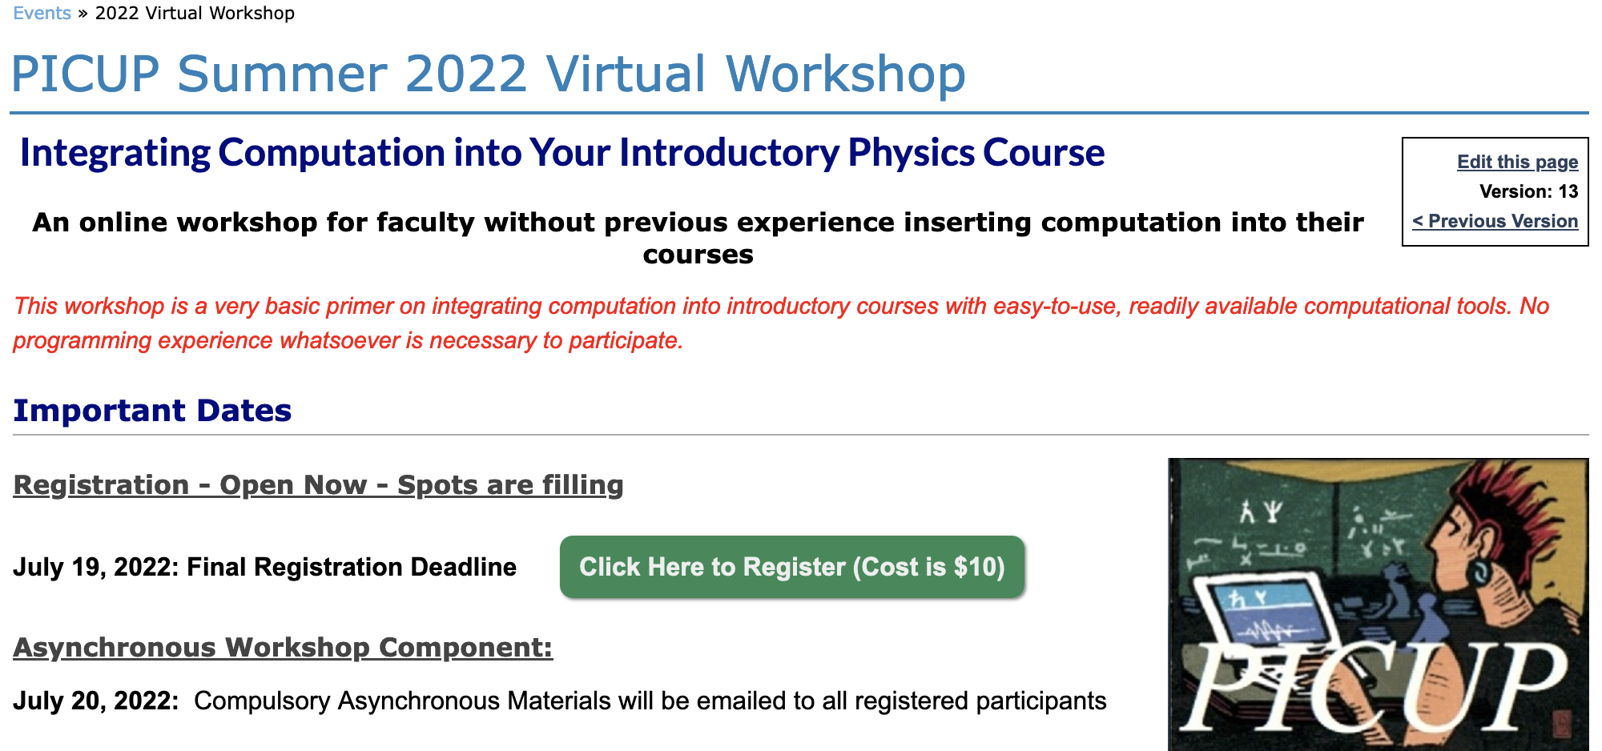
Workshop!
Summer 2022 Virtual Workshop
Aug 2-4
Sign up by July 19
Go to Events Tab
Notes:
Highlight upcoming workshop
Third annual Summer Virtual Workshop
Getting started sign up
Encourage colleagues to sign up
Great way to attain department-wide integration is have colleague attend workshop
Questions about FDW
Currently working on a grant submission. Hope to have in-person workshops in the not too distant future.

Slide 22
What can you do?
Submit Exercise Sets
Share activities in Faculty Commons
Write posts for Resources
Stay connected with the community
Notes:
May wonder what you can do

Slide 23
ES Needs¹
EJS
C++
PhET-style simulations
High-school material
Upper-level material
Condensed Matter Physics
High Energy/Particle Physics
Biophysics
Chemical/Molecular Physics
1) Lane, W. Brian. "Analysis of the PICUP Collection: Strengths and Areas for Development." arXiv preprint arXiv:2103.02408 (2021).

Slide 24
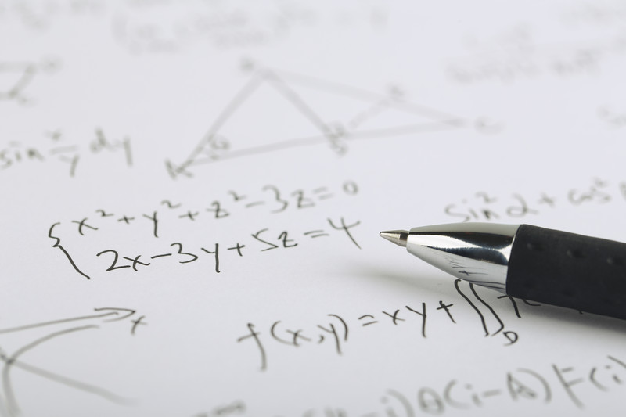
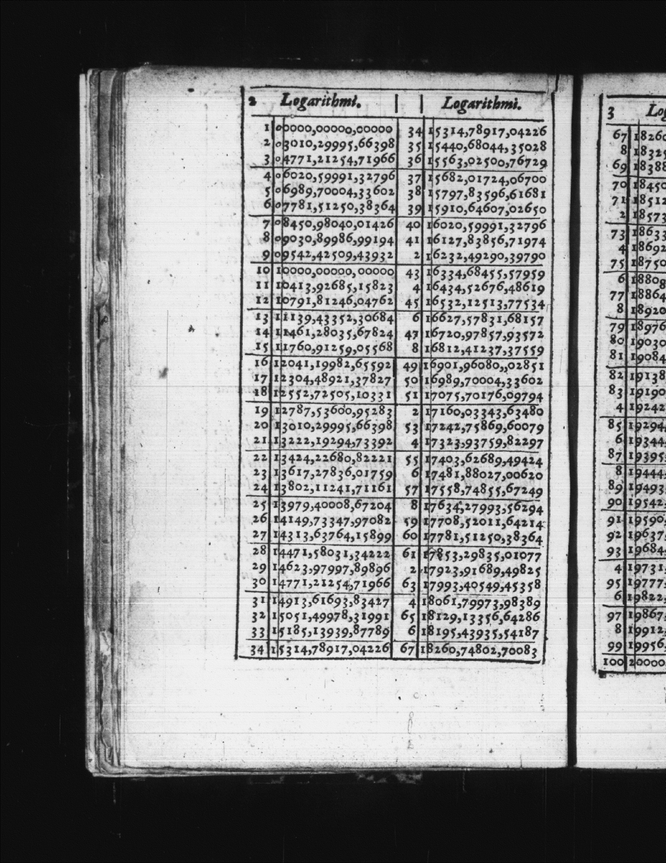
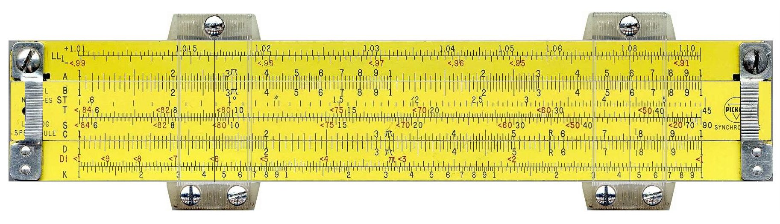
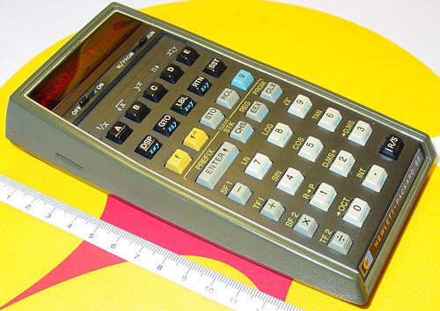
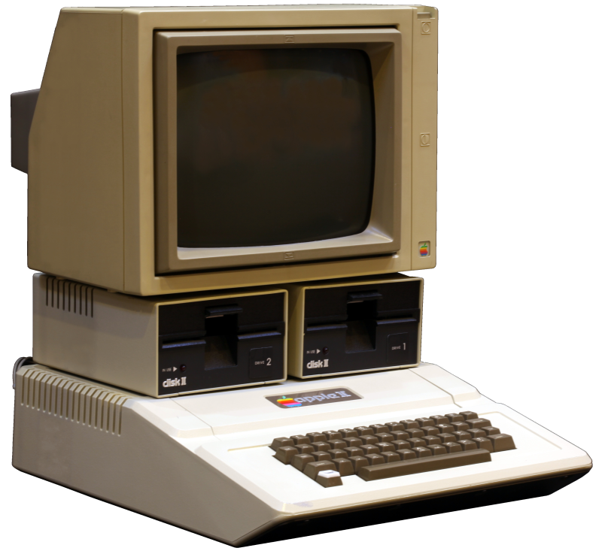

A Short History of Computation
Hand-written math: ~ 3000 BCE - …
Logarithm Tables: 1614 to ?
Slide Rules: 1620 to 1975
Handheld Calculator: 1972 - …
Personal Computer: 1977 – …
Python: 1989 - …
Notes:
Log Table: By Henry Briggs - http://www.pmonta.com/tables/logarithmorum-chilias-prima/index.html, Public Domain, https://commons.wikimedia.org/w/index.php?curid=43431356
Slide rule: By teclasorg - Flickr, CC BY-SA 2.0, https://commons.wikimedia.org/w/index.php?curid=1173203
Calculator: By Rama, CC BY-SA 2.0 fr, https://commons.wikimedia.org/w/index.php?curid=29591429
Python Logo: www.python.org [GPL (http://www.gnu.org/licenses/gpl.html)]
Leave you with something to mull over.
At workshops people ask what needs to give to add in computation
Few want to remove any analytical methods
Important lesson to learn from the sliderule
Switch to electronic calculator:
Loose number sense
Loose ability to do order-of-magnitude calcs
Gains from calculator made up for any loses
At what point will the benefits of adding computation outweight the loses of removing analytical solutions?
Don’t think we are there but need to have conversation now

Slide 25
Thank You
Resource Development: Lyle Barbato, Kelly Roos, Larry Engelhardt
Other PICUP Leadership: Marie Lopez del Puerto, Danny Caballero, Robert Hilborn, and Norman Chonacky
Evaluator: Alexis Knaub
PICUP Associate Editors and Reviewers
You, the PICUP community
Thank you to the UW-Stout Chancellor, STEMM Dean, and Department of Chemistry and Physics Chair for funding
Link to slides

Slide 26
Links
Shodor Visioning Workshop
Computing in Science and Engineering Special Issue on Physics Computation
Fuller, Robert G. "Numerical computations in US undergraduate physics courses." Computing in science & engineering 8.5 (2006): 16-21.
Caballero, Marcos D., and Laura Merner. "Prevalence and nature of computational instruction in undergraduate physics programs across the United States." Physical Review Physics Education Research 14.2 (2018): 020129.
Leary, Ashleigh, Irving, Paul W., and Caballero, Marcos D. The difficulties associated with integrating computation into undergraduate physics. Proceedings of the Physics Education Research Conference (2018).

